Slide 1
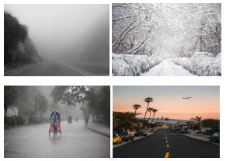

Classification of weather using CNN and deep learning
Presented By:
Pranjal Pandey
Byreddy Vishnu
Suhas Cholleti
Under guidance of Prof. Niyazi Sorkunlu

Slide 2


Index
Introduction
Goals
Technical Specification
Methodology
Result
Conclusion
Future Scope

Slide 3
Introduction
Determining the weather from a single image is a simple task for an average human but classifying is not.
In this project, a weather classification method has been proposed by using Computer vision and deep learning technology.
It extracts the various the photometric property of the image such as color and texture of the image to detects the weather condition
There are generally two type images to deal with: static weather conditions → sunny, hazy, fog dynamic weather →raining, snowing dust storm and hailstorm.

Slide 4
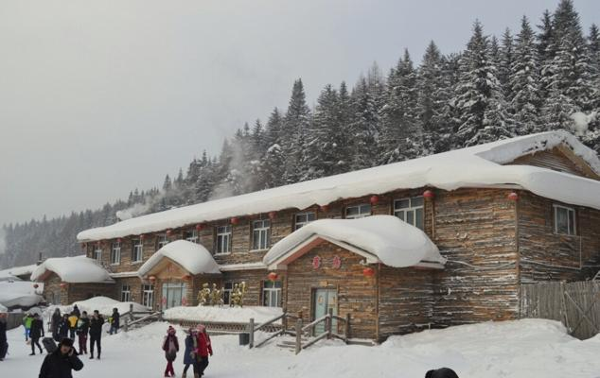
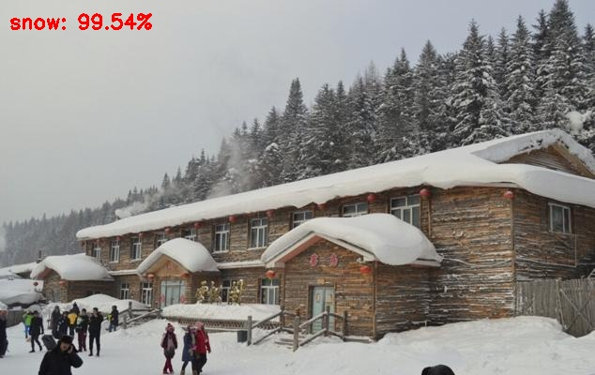
Introduction

Slide 5
Goals
To Determine the weather Condition from the Image.
To train the image dataset and store them with proper weather Labels.
Implement various machine learning techniques and compare the results
To select the best algorithm for our problem based on the accuracy of result.
Improving the training dataset with larger data sets of images.

Slide 6
Technical Specifications
PyCharm IDE With Python 3.7
DataSet : Multi-class Weather Recognition
Libraries: Sklearn, OpenCV, Numpy, Keras

Slide 7
Methodology
KNN
Decision Tree
Random Forest
Naïve-Bayes
CNN

Slide 8
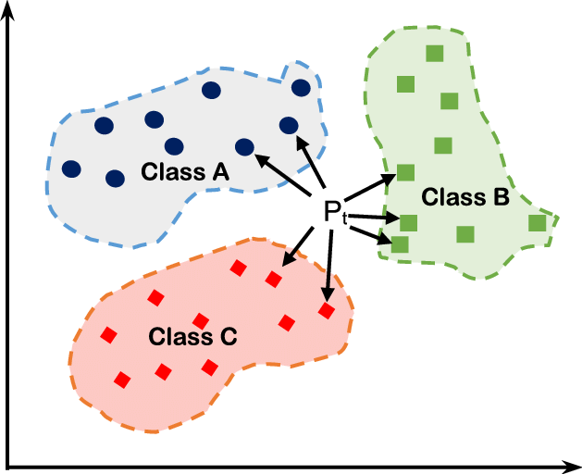
K-nearest neighbors
K-nearest neighbors algorithm assumes that the vectors with the same properties exist near to each other
The images are divided into data points and the same category image will be relative to closer datapoints

Slide 9
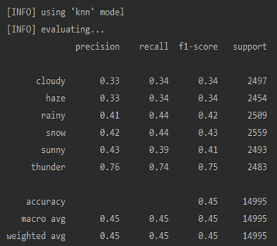
K-nearest neighbors
Observation : low in accuracy but is relatively easy to implement, accuracy decreases with large dataset
Parameters : Value of K, distance function

Slide 10
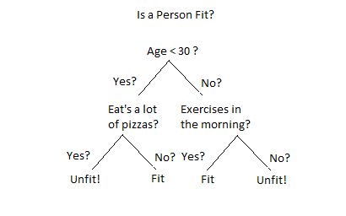
Decision Trees
It basically works in the principle of divide and conquer and recursive partitioning
It is loaded with a series of tests that determine the label of the image

Slide 11
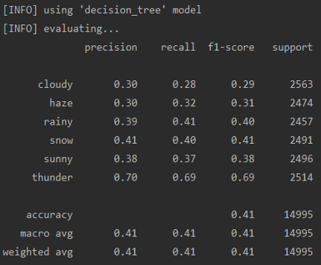
Decision Trees
Observation : low in accuracy, each trial is faster, follows tree data structure
Parameters : Max Depth, min sample leaf

Slide 12
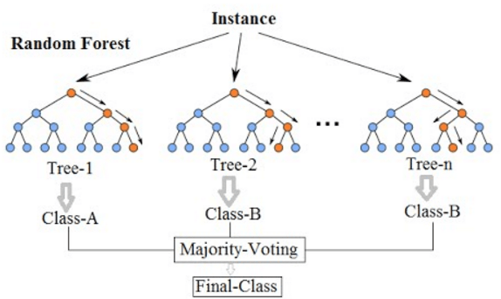
Random Forest
It is the collection of the decision trees, i.e. the basic building blocks of random forest are decision trees
While growing the trees it searches for the best feature among the random subset.
This results in diversity which generally yields better results
It basically works in the principle of divide and conquer and recursive partitioning
It is loaded with a series of tests that determine the label of the image

Slide 13
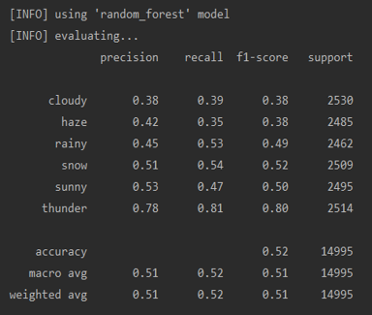
Random Forest
It is the collection of the decision trees, Observation : accuracy Increases, each trial becomes slower, collection of decision trees
Parameters : Trees, M iterations

Slide 14
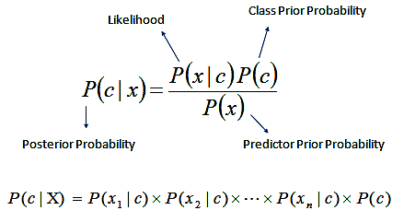
Naïve Bayes
This machine learning algorithm learns by looking at the training sets
Probabilistic classifier : It looks at the probability of assigning a class given a specific set of features
It will assume that each feature is independent of each other

Slide 15
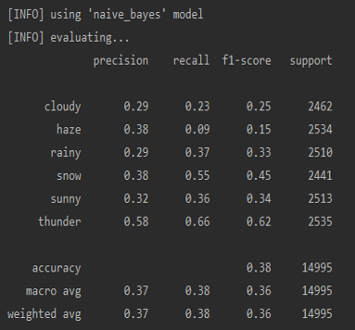
Naïve Bayes
Observation : Highly Inefficient, simple Implementation, less accurate with more number of independent predictors
Parameters : Labels, Dataset

Slide 16
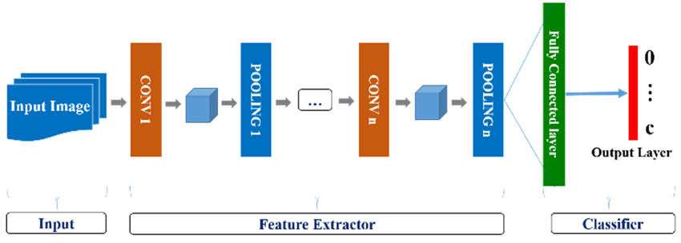
CNN (Convolutional Neural Networks)
The task of image classification using CNN involves reading an input image, converting it into an array of pixels
First Layer: The first layer takes the input image and applies a filter on it
Other layers: Between each convoluted layer there are many layers through which the input image passes

Slide 17
Convolutional Layers
Action
Parameters
I/O
• Apply filters to extract features
• Filters are composed of small kernels, learned.
• One bias per filter.
• Apply activation function on every value of feature map
• Number of kernels
• Size of kernels (W and H only, D is defined by input cube)
• Activation function
• Stride
• Padding
• Regularization type and value
• Input: 3D cube, previous set of feature maps
• Output: 3D cube, one 2D map per filter

Slide 18
Pooling Layers
Action
Parameters
I/O
• Reduce dimensionality
• Extract maximum of average of a region
• Sliding window approach
• Stride
• Size of Window
• Input: 3D cube, previous set of feature maps
• Output: 3D cube, one 2D map per filter, reduce spatial dimensions

Slide 19
Fully Connected Layers
Action
Parameters
I/O
• Aggregate information from final feature maps
• Generate final classification
• Number of nodes
• Activation function: usually changes depending on role of layer. If aggregating info, use ReLU. If producing final classification, use Softmax.
• Input: FLATTENED 3D cube, previous set of feature maps
• Output: 3D cube, one 2D map per filter

Slide 20
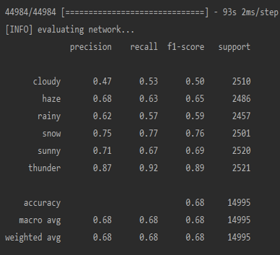
CNN (Convolutional Neural Networks)
Observation : Highly Efficient, little less accurate for cloudy and haze

Slide 21

Metrics for comparison
Calculating weighted accuracy using precision, recall, F1 score.
Using the Weighted accuracy to compare the different machine learning techniques
A false positive is a result that indicates True, when it does not
A false negative is a result that indicates False, while in fact it does.

Slide 22
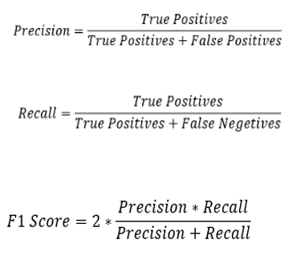
Metrics for comparison
Precision is useful when we want low False Positives
Recall is useful when we want low False Negatives
F1 score combines both Precision and recall. It has a range of 0 to 1.
F1 score is good when we want both False Positives and False Negatives to be low.

Slide 23
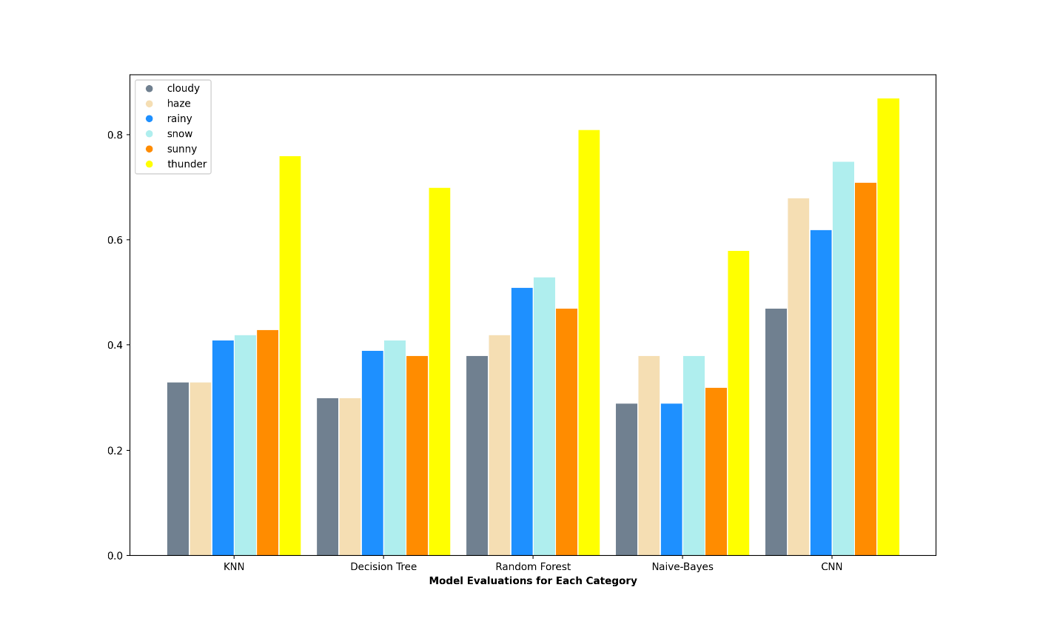
Result

Slide 24
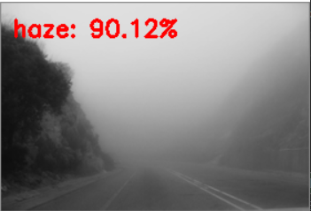
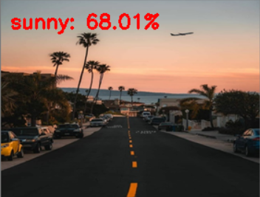
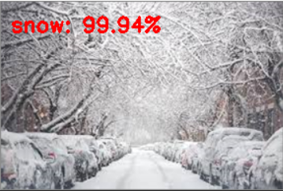
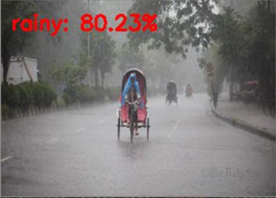
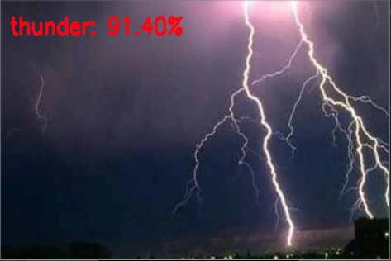
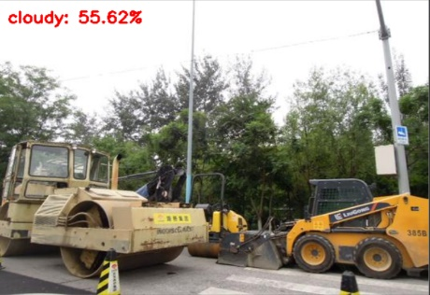
Result

Slide 25

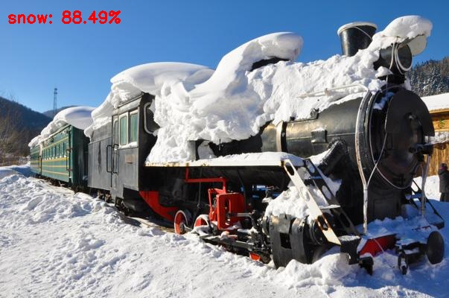
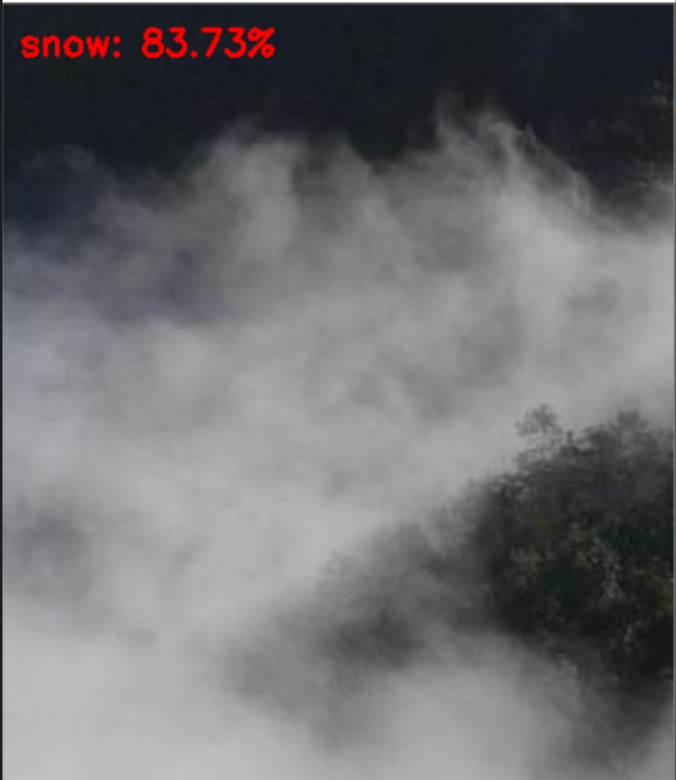
Conclusion
Our model is also not able to predict correctly when the image represents multiple weather conditions such as the shown in the first Image
But our model struggles to predict weather conditions such as cloudy, haze and snow
In general these images have a lot of white pixels. As seen from the second image the model is not able to differentiate white clouds from snow.

Slide 26
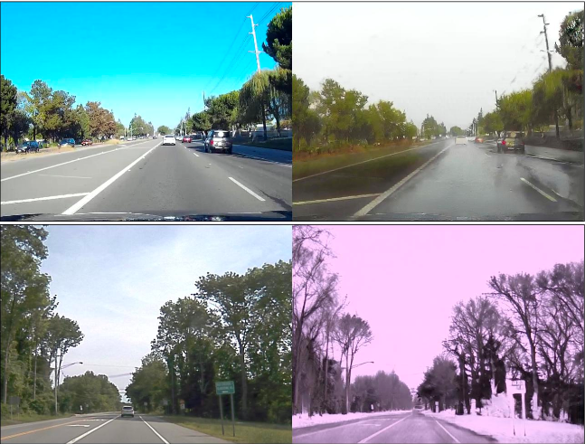
Future Scope
Once the image has been classified, we can further translate the image to view the image in a different weather condition
Classify a single image with multiple CNN models trained for detecting specific weather conditions. This will allow us to detect multiple weather conditions in the same image

Slide 27
References
Q. Li, Y. Kong and S. Xia, "A method of weather recognition based on outdoor images," 2014 International Conference on Computer Vision Theory and Applications (VISAPP), Lisbon, 2014, pp. 510-516.
Z. Zhu, L. Zhuo, P. Qu, K. Zhou and J. Zhang, "Extreme Weather Recognition Using Convolutional Neural Networks," 2016 IEEE International Symposium on Multimedia (ISM), San Jose, CA, 2016, pp. 621-625.
M. Elhoseiny, S. Huang and A. Elgammal, "Weather classification with deep convolutional neural networks," 2015 IEEE International Conference on Image Processing (ICIP), Quebec City, QC, 2015, pp. 3349-3353.
RSCM: Region Selection and Concurrency Model for Multi-class Weather Recognition : http://vcc.szu.edu.cn/research/2017/RSCM.html

Slide 28

THANKS!
Any questions?

